Slide 1

ECE 419/619
Electric Machines and Drives
Programming Motor Drives
Using Matlab Simulink

Slide 2
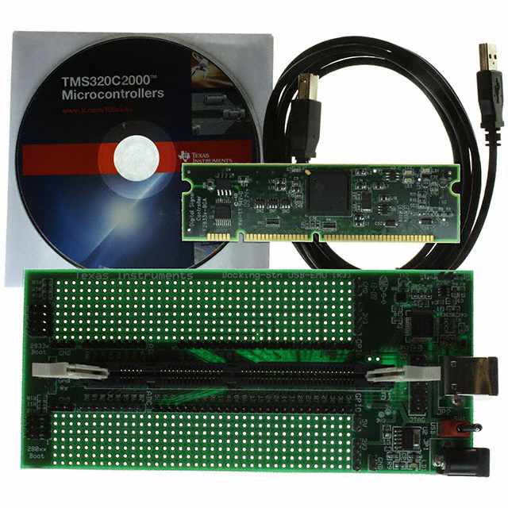
Texas Instruments TMS320F28335 Digital Signal Processor
Floating point CPU (32-bit)
On-board clock (150 MHz)
Sixteen (16) 12-bit analog inputs
Sixty four (64) general purpose digital I/O
PWM and timer outputs
Serial connections (2 CAN, 3 SCI, 2 McBSP)
On-chip memory (Flash and SRAM)
Boot ROM
DSP board: $60.00
Docking station: $40.00
Code Composer v3.3: $0.00
From Digi-Key: 296-23544-ND

Slide 3
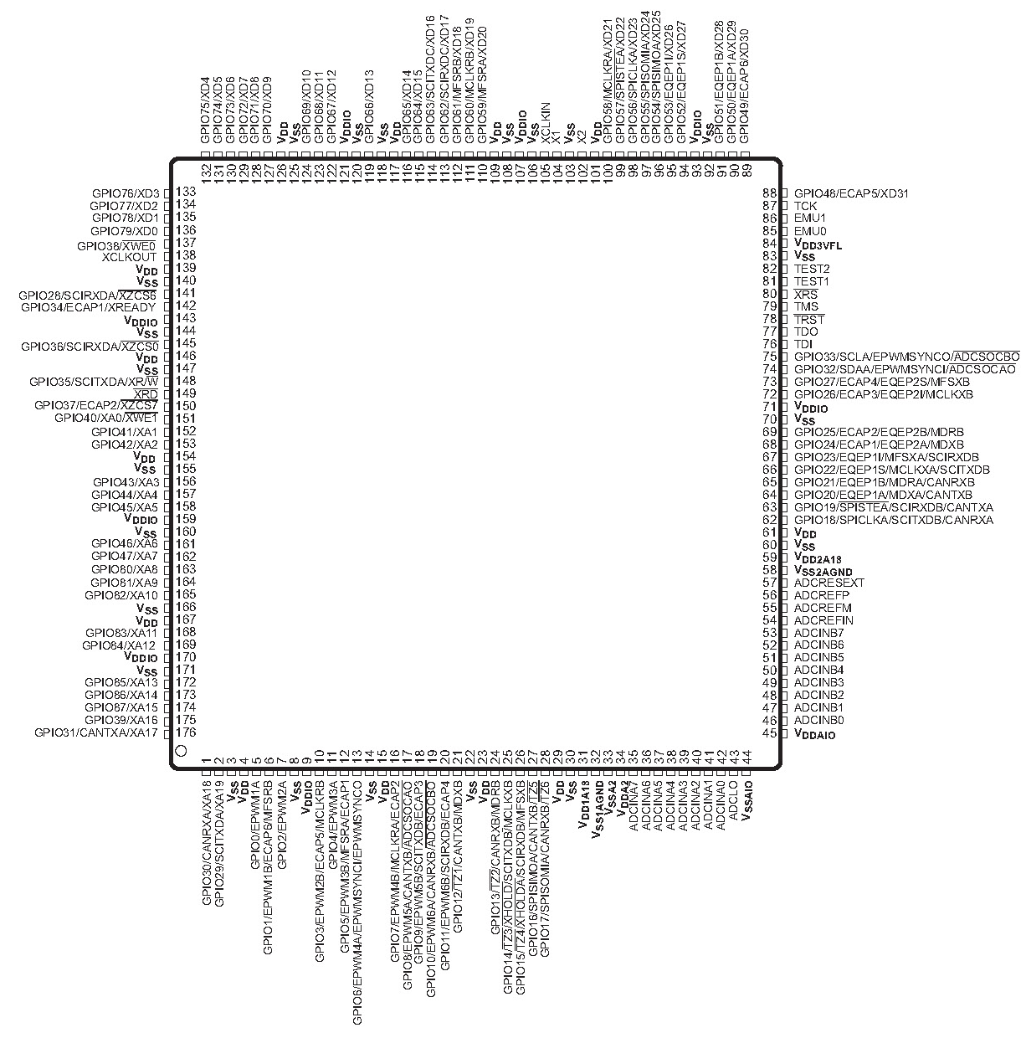
TMS 320F28335 Pin Assignment
from TMS 320F28335
Data Manual

Slide 4
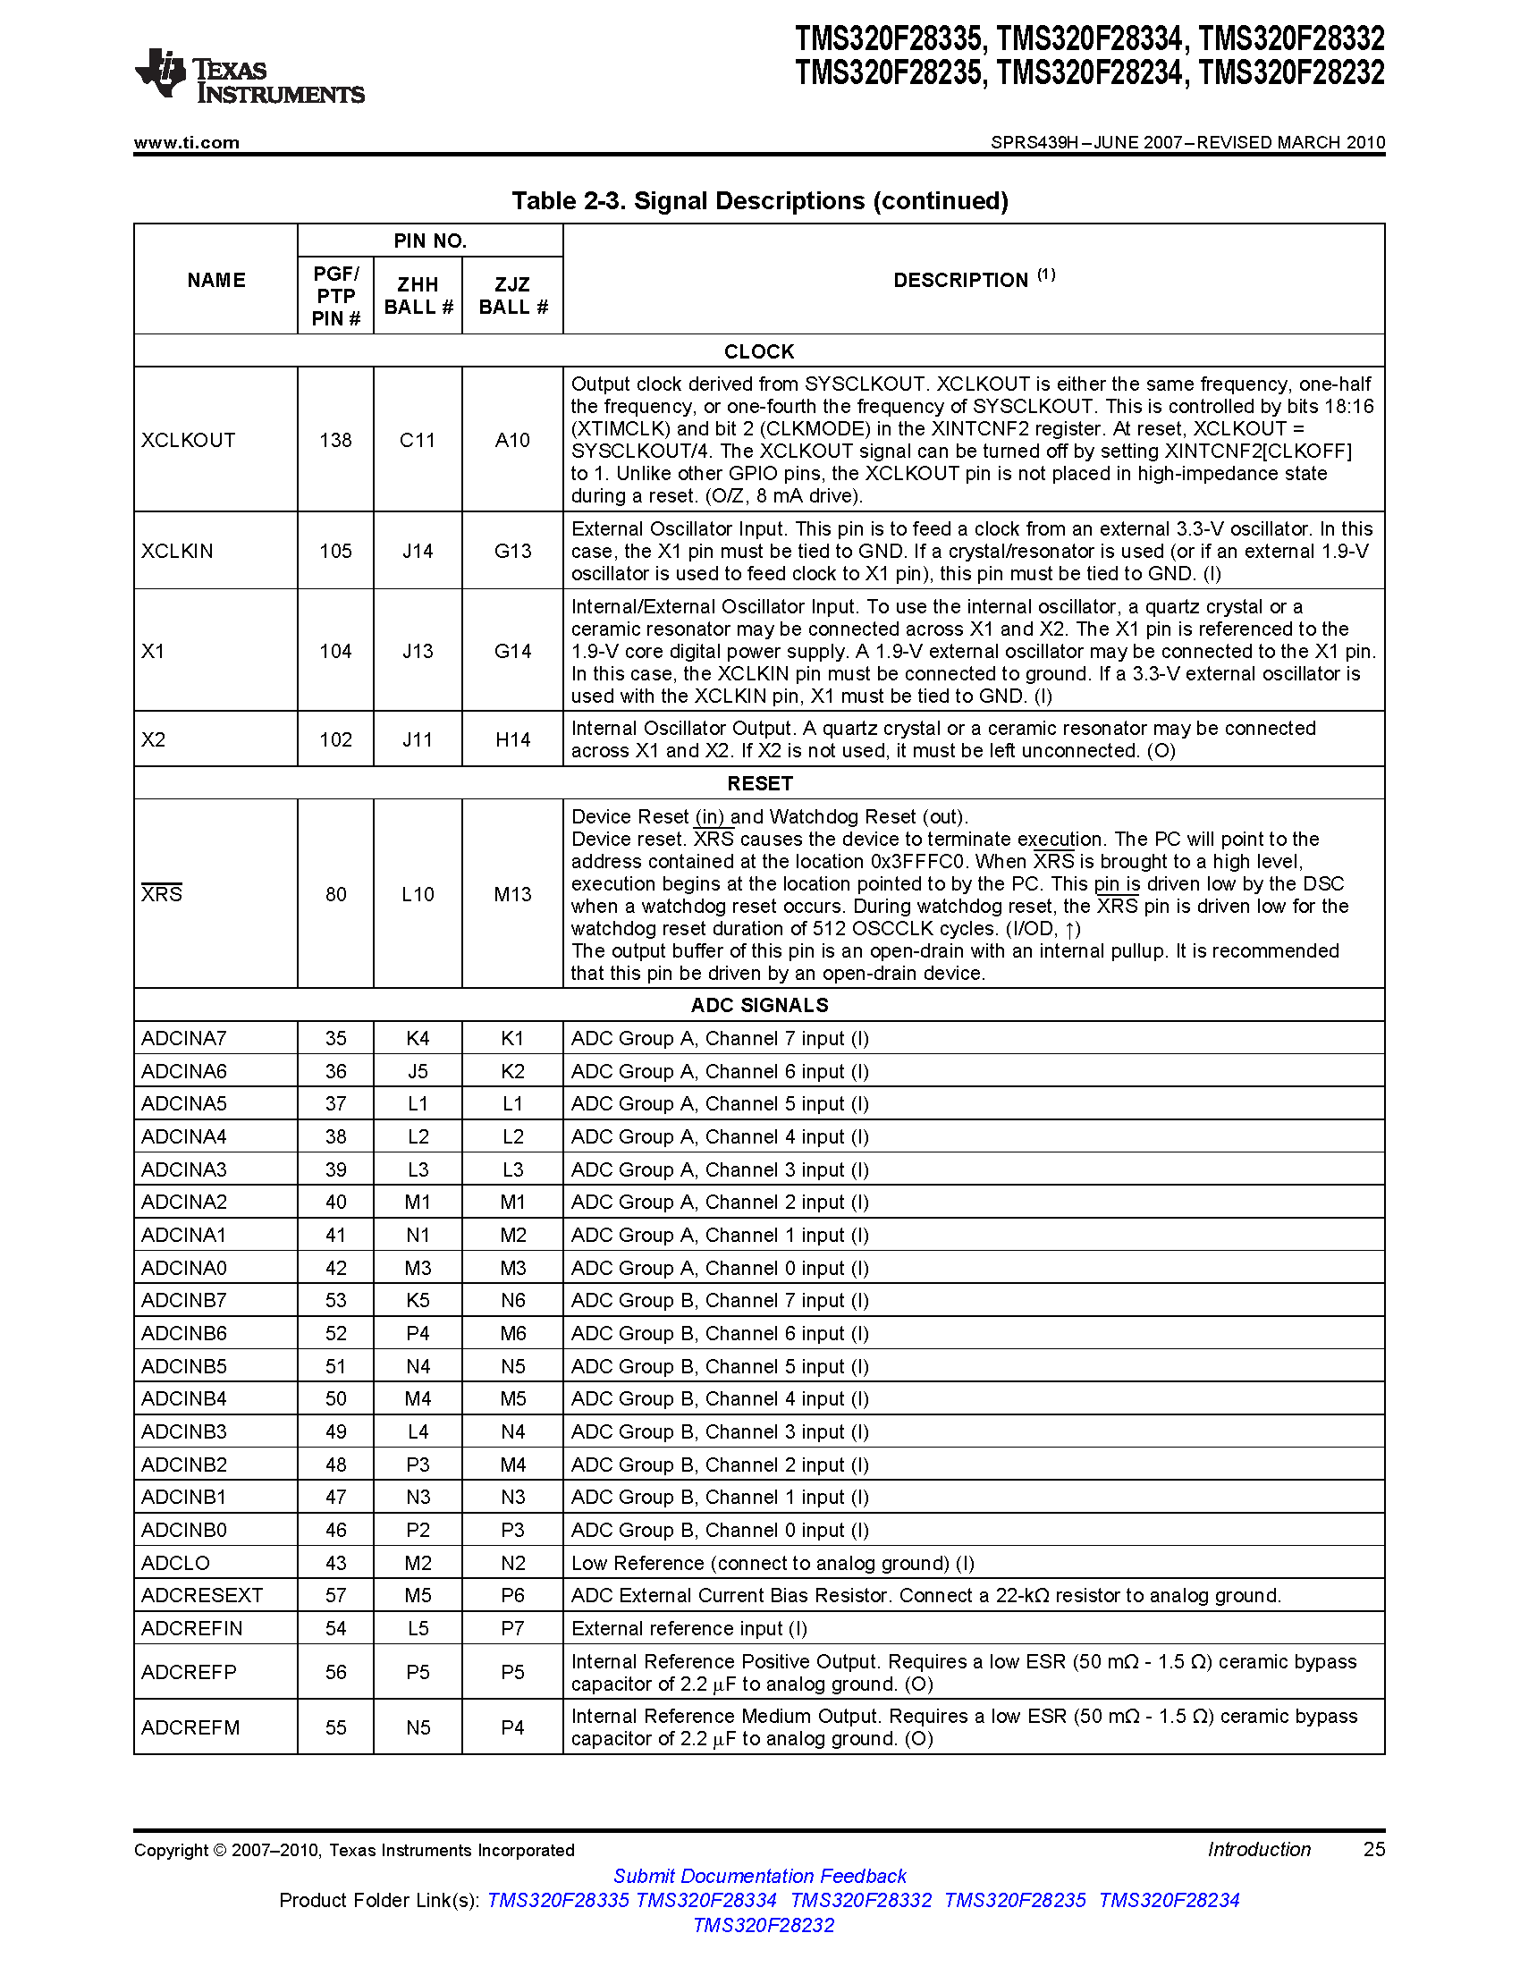

Slide 5
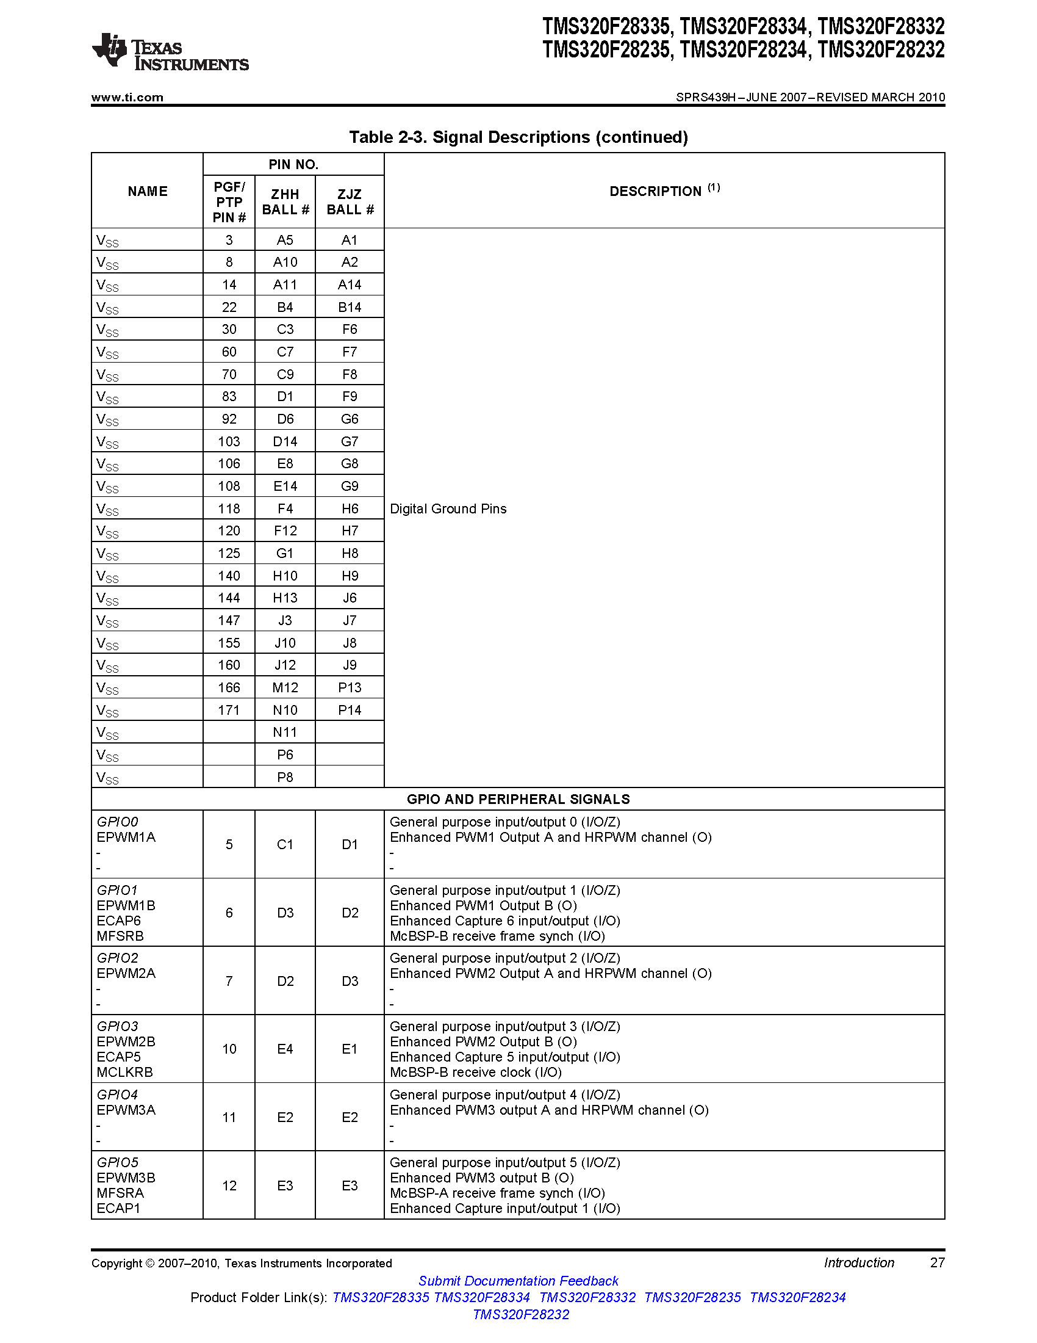

Slide 6
TI TMS320F28335 DSP
Relatively inexpensive ($100) yet powerful DSP
Sixteen (16) 12-bit analog inputs
Sixty four (64) general purpose digital I/O
PWM and timer outputs
Serial connections (2 CAN, 3 SCI, 2 McBSP)
Comes with Code Composer v3.3
Can be programmed using C
Can be programmed from Matlab Simulink

Slide 7
V/Hz Induction Motor Drive Example
Create power section using SimPower Blocks
Place control section in a triggered subsystem
Utilize discrete blocks for control
Example contained in three files
m-file
simulation file
DSP programming file

Slide 8
M File
% Timing
Ts = 1e-6;
Fsw = 10e3;
T_sec = 1/Fsw;
% Induction motor parameters
Pb = 3.7e3;
fb = 40;
VLL = 230;
poles = 4;
rs = 0.3996;
Lls = 5.73e-3;
rr = 0.2266;
Llr = 4.64e-3;
Lm = 64.43e-3;
J = 0.15;
Bm = 750e-6;
flimit = 60;
% System parameters
Rbreak = 100/2;
Rprecharge = 2.2e3/2;
Cdc = (1000e-6/2)*2+2*60e-6;
Rdc = ((100e3/2)/2)*2;
% Filter cut-off frequency
fc = 3e3;
% Breaking chopper constants
Vdc_min = 350;
Vdc_max = 450;
Kvdc = 1/(Vdc_max-Vdc_min);
% Pre-charge constants
Von = 200;
Voff = 100;
% Slew rate limiter constants
rtime = 2;
rate_up = fb/rtime;
rate_dn = -fb/rtime;
% ADC constants
R1 = 30e3;
R2 = 43e3;
R3 = 10e3;
Vref = 10;
vk = 1+(R1/R2)+(R1/R3);
vo = -(R1/R2)*Vref;
Avdc = 1/10e-3;

Slide 9
Simulation File: Power Section

Slide 10
Simulation File: Control section
Inside the triggered subsystem

Slide 11
V/Hz, Simulation File Electrical Angle
Inside the Theta Gen block
(example of using discrete blocks)

Slide 12
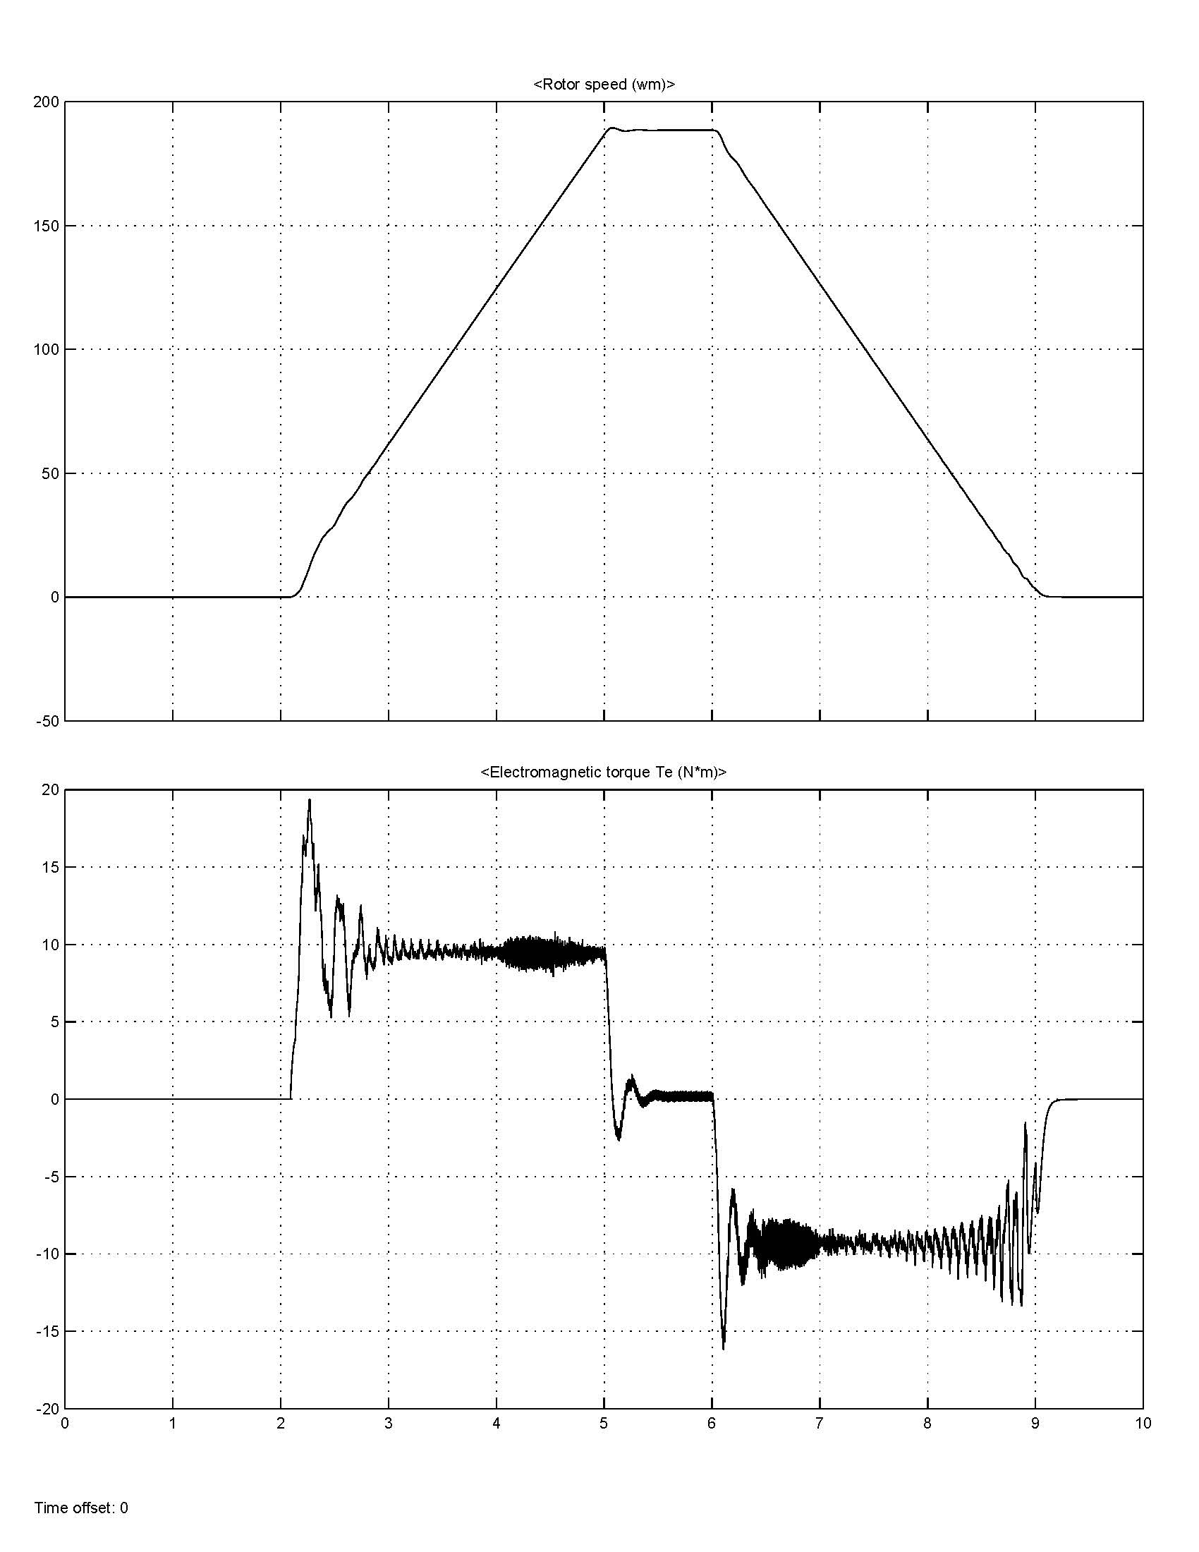
Simulation Output

Slide 13
DSP Programming File
Copy the control from the simulation file into a triggered subsystem without inputs and outputs
Add a hardware interrupt and DSP block
Add DSP input and output blocks as well as signal conditioning

Slide 14
DSP Programming File: Top Level

Slide 15
DSP Programming File: V/Hz control

Slide 16
DSP Programming File: PWM Outputs

Slide 17
DSP Programming File:
Breaking Chopper Control

Slide 18
DSP Programming File:
Pre-Charge and Fault Logic

Slide 19
Steps for Programming the DSP
Start Matlab
Change the working directory to one that contains the files of the drive of interest
Run the .m file to set the variables
Open the DSP Programming .mdl file
Ensure that the DSP is connected to the computer and powered on
Click on the incremental build icon
Matlab will start Code Composer, compile the file, and load it on the DSP
When Code Composer displays "RUNNING" the DSP code is running

Slide 20
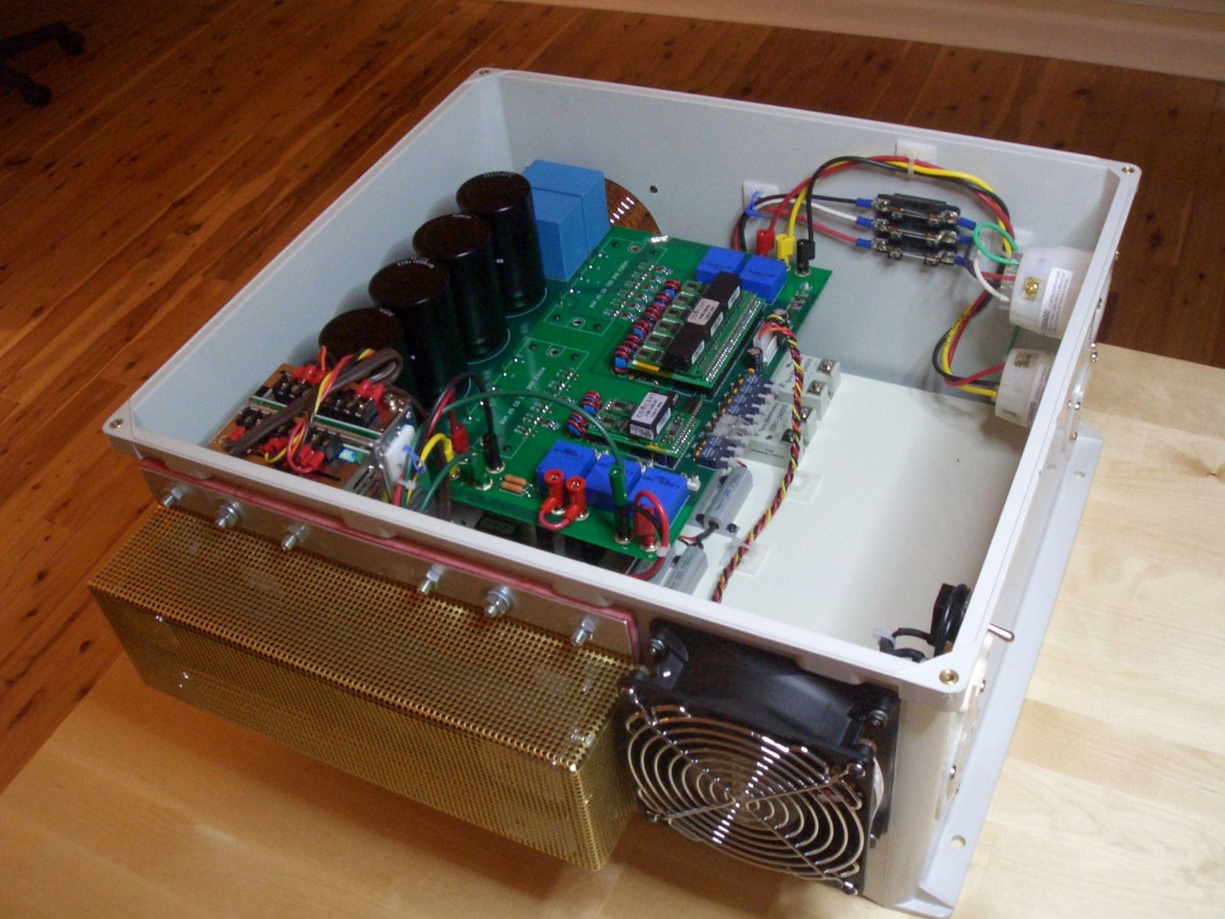
Drive Hardware

Slide 21
Volts/Hertz DSP Programming Example
Demonstrates a Simulink simulation of a standard V/Hz induction motor drive
Breaking resistor and
Control in simulation is carried out using discrete blocks instead of integrators
By adding blocks from the Target Support Package, the simulation can be modified to program a DSP
ADC
ePWM
GPIO DI
GPIO DO

